Slide 1

Department Of Computer Science, CUI Lahore Campus
CSC102 - Discrete Structures
By
Mahwish Waqas

Slide 2
Lecture Outline
Rules of Inference
What is an argument and argument form?
Rules of inference
Proof using rules of Inference
Fallacy

Slide 3
Rules of Inference
Rules of inference are templates for constructing valid arguments.
Rules of inference are basic tools for establishing the truth of statements.
Valid means that the conclusion of the argument must follow from the truth of the preceding statements of the argument.

Slide 4
Argument
An Argument is a sequence of propositions.
1. If you have the current password, then
you can log onto the network.”
2. “You have a current password.”
Therefore,
3. “You can log onto the network.”

Slide 5
Premises and Conclusion
Therefore,
All but the final proposition are called premises.
The final proposition is called the conclusion.
1. If you have the current password, then you can log onto the network.”
2. “You have a current password.”
Premises
3. “You can log onto the network.”
Conclusion

Slide 6
Valid Arguments
Therefore,
An argument is valid if the truth of all premises implies that conclusion is true.
1. If you have the current password, then you can log onto the network.”
2. “You have a current password.”
Premises true
3. “You can log onto the network.”
Conclusion true

Slide 7
Valid Arguments
An Argument form in propositional logic is sequence of compound propositions involving propositions variables. An argument form is valid if no matter which particular propositions are substituted for the propositional variables in its premises, the conclusion is true if the premises are all true.

Slide 8
Valid Arguments
1. If you have the current password, then you can log onto the network.”
2. “You have a current password.”
Therefore,
3. “You can log onto the network.”

Slide 9
Valid Arguments (Argument Form)
1. If you have the current password, then you can log onto the network.”
2. “You have a current password.”
Therefore,
3. “You can log onto the network.”
Argument form:
Hypothesis 1
1. If p, then q
2. p
therefore
3. q q
p → q
p
∴ Q
Hypothesis 2
Conclusion

Slide 10
Modus Ponens
The tautology (p ∧ (p→q)) → q is basis of modus ponens.
p | q | p→q | p∧(p→q)) | (p∧(p→q)) → q
T | T | T | T | T
T | F | F | F | T
F | T | T | F | T
F | F | T | F | T
p
p → q
∴ q

Slide 11
Modus Ponens
The tautology (p ∧ (p→q)) → q is basis of modus ponens.
In particular, modus ponens tells us that if a conditional statement and the hypothesis of this conditional statement are both true, then the conclusion must also be true.

Slide 12
Modus Ponens Example
Assume you are given the following two statements:
“you are in this class”
“if you are in this class, you will get a grade”
Let p = “you are in this class”
Let q = “you will get a grade”

Slide 13
Modus Ponens Example
Assume you are given the following two statements:
“you are in this class”
“if you are in this class, you will get a grade”
Let p = “you are in this class”
Let q = “you will get a grade”
By Modus Ponens, you can conclude that “you will get a grade”.

Slide 14
Modus Ponens Example
Consider the following statements
“If it snows today, then we will stay at home”
“It is snowing today”
Let p = “it is snowing today”
Let q =“we will stay at home”

Slide 15
Modus Ponens Example
Consider the following statements
“If it snows today, then we will stay at home”
“It is snowing today”
Let p = “it is snowing today”
Let q =“we will stay at home”
By Modus Ponens, you can conclude that “We will stay at home”.

Slide 16
Modus Tollens
Assume that we know: ¬q and p → q
Recall that p → q ≡ ¬q → ¬p
Thus, we know ¬q and ¬q → ¬p
We can conclude ¬p
¬ q
p → q
∴ ¬ p

Slide 17
Modus Tollens Example
Assume you are given the following two statements:
“you will not get a grade”
“if you are in this class, you will get a grade”
Let p = “you are in this class”
Let q = “you will get a grade”

Slide 18
Modus Tollens Example
Assume you are given the following two statements:
“you will not get a grade”
“if you are in this class, you will get a grade”
Let p = “you are in this class”
Let q = “you will get a grade”
By Modus Tollens, you can conclude that you are not in this class

Slide 19
Addition & Simplification
Addition: If you know that p is true, then p ∨ q will ALWAYS be true i.e. p → p ∨ q
p
∴ p ∨ q
Simplification: If p ∧ q is true, then p will ALWAYS be true i.e. p ∧ q → p
p ∧ q
∴ p

Slide 20
Addition Example
Assume you are given the following statements:
“ It is below freezing now. Therefore, it is either below freezing or raining now”
Let p = “It is below freezing now”.
Let q = “It is raining now”.
Then this argument is of the form
p
∴ p ∨ q

Slide 21
Simplification Example
Assume you are given the following statements:
“ It is below freezing and raining now. Therefore, it is below freezing now”
Let p = “It is below freezing now”.
Let q = “It is raining now”.
This argument is of the form
p ∧ q
∴ p

Slide 22
Hypothetical Syllogism
If p → q is true, and q → r is true, then p → r must be true
p → q
q → r
∴ p → r

Slide 23
Hypothetical Syllogism Example
Assume you are given the following statements:
If it rains today, then we will not have a barbecue today. If we do not have a barbecue today, then we will have a barbecue tomorrow. Therefore, if it rains today, then we will have a barbecue tomorrow.

Slide 24
Hypothetical Syllogism Example
Assume you are given the following statements:
If it rains today, then we will not have a barbecue today. If we do not have a barbecue today, then we will have a barbecue tomorrow. Therefore, if it rains today, then we will have a barbecue tomorrow.
Let p = “It is raining today,”
Let q = “We will not have a barbecue today,”
Let r =“We will have a barbecue tomorrow.”

Slide 25
Hypothetical Syllogism Example
Assume you are given the following statements:
If it rains today, then we will not have a barbecue today. If we do not have a barbecue today, then we will have a barbecue tomorrow. Therefore, if it rains today, then we will have a barbecue tomorrow.
Let p = “It is raining today,”
Let q = “We will not have a barbecue today,”
Let r =“We will have a barbecue tomorrow.”
Then this argument is of the form
p → q
q → r
∴ p → r

Slide 26
Exercise
What rule of inference is used in each of these arguments?
Alice is a mathematics major. Therefore, Alice is either
a mathematics major or a computer science major.
Addition
Jerry is a mathematics major and a computer science major. Therefore, Jerry is a mathematics major.
Simplification
If it is rainy, then the pool will be closed. It is rainy.
Therefore, the pool is closed.
Modus Ponens

Slide 27
Exercise
If it snows today, then university will close. The university is not closed today. Therefore, it did not snow today.
Modus Tollens
If I go swimming, then I will stay in the sun too long. If I stay in the sun too long, then I will sunburn. Therefore, if I go swimming, then I will sunburn.
Hypothetical Syllogism

Slide 28
Steps for Proof
Identify the atomic propositions and represent using propositional variable.
Make the argument from
Proof using rules of inference

Slide 29
Example Proof
We have the hypotheses:
“It is not sunny this afternoon and it is colder than yesterday”
“We will go swimming only if it is sunny”
“If we do not go swimming, then we will take a canoe trip”
“If we take a canoe trip, then we will be home by sunset”
Can it lead to the conclusion that “we will be home by sunset”?
((¬ s ∧ c) ∧ (m → s) ∧ (¬ m → t) ∧ (t → h)) → h ???
Where
s = “It is sunny this afternoon”; c = “it is colder than yesterday”
m = “We will go swimming”; t = “we will take a canoe trip”
h = “we will be home by sunset”

Slide 30
Example of Proof
¬s ∧ c 1st hypothesis
¬s Simplification using step 1
m → s 2nd hypothesis
¬m Modus tollens using steps 2 & 3
¬m → t 3rd hypothesis
t Modus ponens using steps 4 & 5
t → h 4th hypothesis
h Modus ponens using steps 6 & 7

Slide 31
Example Proof
“If it does not rain or it is not foggy, then the sailing race will be held and the lifesaving demonstration will go on”
(¬ r ∨ ¬ f) → (s ∧ d)
“If the sailing race is held, then the trophy will be awarded”
s → t
“The trophy was not awarded”
¬ t
Can you conclude: “It rained”?

Slide 32
Example of Proof
¬t 3rd hypothesis
s → t 2nd hypothesis
¬s Modus tollens using steps 1 & 2
(¬r∨¬f)→(s∧d) 1st hypothesis
¬(s∧d)→¬(¬r∨¬f) Contrapositive of step 4
(¬s∨¬d)→(r∧f) DeMorgan’s law and double negation law
¬s∨¬d Addition from step 3
r∧f Modus ponens using steps 6 & 7
r Simplification using step 8

Slide 33
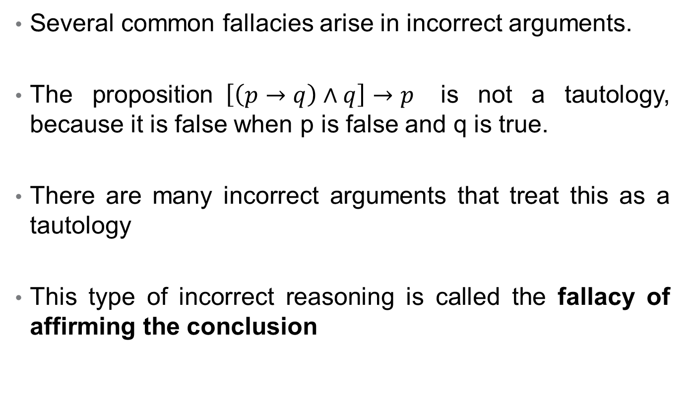
Fallacies
Several common fallacies arise in incorrect arguments.
The proposition$\left[\left(p→q\right)∧q\right]→p$ is not a tautology, because it is false when p is false and q is true.
There are many incorrect arguments that treat this as a tautology
This type of incorrect reasoning is called the fallacy of affirming the conclusion

Slide 34
Example
Consider the following argument
If you do the every problem in this book, then you will learn discrete mathematics. You learned discrete mathematics
Therefore
You did every problem in this book
Let p = “you do the every problem in this book”
q = “you learned discrete mathematics”
p → q
q
∴ p

Slide 35
Summary: Rules of Inference
Rules of Inference | Tautology | Name
p p → q ∴ q | (p ∧ (p → q)) → q | Modus ponens
￢q p → q ∴ ￢p | (￢q ∧ (p → q))→￢p | Modus tollens
p → q q → r ∴ p → r | ((p → q) ∧ (q → r)) → (p → r) | Hypothetical syllogism
p ∨ q ￢p ∴ q | ((p ∨ q)∧￢p) → q | Disjunctive syllogism

Slide 36
Summary: Rules of Inference
Rules of Inference | Tautology | Name
p ∴ p ∨ q | p → (p ∨ q) | Addition
p ∧ q ∴ p | (p ∧ q) → p | Simplification
p q ∴ p ∧ q | ((p) ∧ (q)) → (p ∧ q) | Conjunction
p ∨ q ￢p ∨ r ∴ q ∨ r | ((p ∨ q) ∧ (￢p ∨ r)) → (q ∨ r) | Resolution

Slide 37
Example Proof
We have hypotheses
“If you send me an e-mail message, then I will finish writing the program,”
“If you do not send me an e-mail message, then I will go to sleep early,”
“If I go to sleep early, then I will wake up feeling refreshed”
The conclusion “If I do not finish writing the program, then I will wake up feeling refreshed.”
Let p = “You send me an e-mail message,”
q = “I will finish writing the program,”
r = “I will go to sleep early,”
s = “I will wake up feeling refreshed.”

Slide 38
Example Proof
p → q 1st Hypothesis
￢q →￢p Contrapositive of 1
￢p → r 2nd Hypothesis
￢q → r Hypothetical syllogism using 2 and 3
r → s 3rd Hypothesis
￢q → s Hypothetical syllogism using 4 and 5

